Slide 1
PERFORMANCE REPORT
J.GEORGE
Notes:
Title Slide

Slide 2
% of Growth over FY 22-23 VS FY 23-24
LH FY 23-24 Total Market Share Gain over FY 22- 23 = 14.5 %
C&M FY 23-24 Total Market Share Gain over FY 22- 23 = -3 %
 | VERTICAL | LH
LH | Target | 22-23 MS | 23-24 MS | % Achieved | % Gain 23 vs 24
Villupuram | 71 | 62 | 64 | 90% | 2
Pondy | 67 | 25 | 52 | 68% | 27
Total Avg | 69 | 43.5 | 58 | 84% | 14.5
 | VERTICAL | C&M
C&M | Target | 22-23 MS | 23-24 MS | % Achieved | % Gain 23 vs 24
Villupuram | 55 | 46 | 32 | 58% | -14
Pondy | 40 | 19 | 27 | 68% | 8
Total Avg | 47.5 | 32.5 | 29.5 | 62% | -3
Notes:
Content Slide

Slide 3
MARKET SHARE PERFORMANCE-LH
Cumulative | Pondy
 | FY 22-23 |  |  | FY 23-24
 | AL | TIV | MS % | AL | TIV | MS % | Delta
4X2 Haulage | 7 | 94 | 7.446809 | 8 | 20 | 40 | 32.6
6X2 MAV | 8 | 18 | 44.44444 | 10 | 20 | 50 | 5.6
8X2 MAV | 5 | 6 | 83.33333 | 5 | 10 | 50 | -33
10X2 MAV | 13 | 14 | 92.85714 | 8 | 12 | 66.66667 | -26
MAV Total | 26 | 38 | 68.42105 | 23 | 42 | 54.7619 | -13.7
Tractors | 0 | 0 | #DIV/0! | 3 | 3 | 100 | 100
Cumulative | Villupuram
 | FY 22-23 |  |  | FY 23-24
 | AL | TIV | MS% | AL | TIV | MS% | Delta MS
4X2 Haulage | 11 | 55 | 20 | 13 | 47 | 28 | 8
6X2 MAV | 3 | 9 | 33.33333 | 5 | 14 | 35.71429 | 2.4
8X2 MAV | 10 | 13 | 76.92308 | 9 | 13 | 69 | -8
10X2 MAV | 73 | 77 | 94.80519 | 68 | 76 | 89.47368 | -5
MAV Total | 86 | 99 | 86.86869 | 82 | 103 | 79.61165 | -7
Tractors | 0 | 2 | 0 | 5 | 7 | 71.42857 | 71
Notes:
Content Slide

Slide 4
MARKET SHARE PERFORMANCE-TIPPER
Cum Mar | Pondy
 |  | FY 22-23 |  |  | FY 23-24 |  | Delta
 | AL | TIV | MS | AL | TIV | MS
4x2 Tipper | 12 | 13 | 92% | 6 | 9 | 67% | -25%
6x4 Tipper | 7 | 58 | 12% | 15 | 37 | 41% | 29%
8x4 Tipper | 7 | 65 | 11% | 11 | 78 | 14% | 3%
10x4 Tipper | 5 | 23 | 22% | 14 | 49 | 29% | 7%
Tipper Total | 31 | 159 | 19% | 46 | 173 | 27% | 8%
Cum Mar | Villupuram
 | FY 22-23 |  |  | FY 23-24 |  |  | Delta
 | AL | TIV | MS | AL | TIV | MS%
4x2 Tipper | 11 | 13 | 85% | 21 | 26 | 81% | -4%
6x4 Tipper | 53 | 126 | 42% | 45 | 135 | 33% | -9%
8x4 Tipper | 90 | 191 | 47% | 55 | 205 | 27% | -20%
10x4 Tipper | 3 | 10 | 30% | 10 | 47 | 21% | -9%
Tipper Total | 157 | 340 | 46% | 131 | 413 | 32% | -14%
Notes:
Content Slide

Slide 5
BUCKET ANALYSIS FY 23-24
Tipper Cummulative 23-24
SL NO | BRANCH | BUCKET STATUS |  |  |  |  |  |  |  |  |  | TOTAL TIV | CUM MS | MC outlet wise
 |  | Lost but not found | Lost and Found | Delayed Known | Fought and Lost |  |  |  |  |  | B5 [AL]
 |  |  |  |  | COMP LOYAL | Service | PRODUCT | PRICE | Finance | B4 TOTAL
1 | TVS VILLUPURAM | 19 | 28 | 23 | 35 | 38 | 114 | 21 | 12 | 220 | 131 | 421 | 31% | 83%
2 | TVS PONDY | 8 | 12 | 9 | 38 | 14 | 40 | 2 | 4 | 98 | 46 | 173 | 27% | 83%
TOTAL |  | 27 | 40 | 32 |  |  |  |  |  | 318 | 177 | 594 | 30% | 83%
PERCENTAGE |  | 5% | 7% | 5% |  |  |  |  |  | 54% | 30%
Long Haulage Cummulative 23-24
SL NO | BRANCH | BUCKET STATUS |  |  |  |  |  |  |  |  |  | TOTAL TIV | CUM MS | MC outlet wise
 |  | Lost but not found | Lost and Found | Delayed Known | Fought and Lost |  |  |  |  |  | B5 [AL]
 |  |  |  |  | COMP LOYAL | Service | PRODUCT | PRICE | Finance | B4 TOTAL
1 | TVS VILLUPURAM | 9 | 7 | 3 | 15 | 6 | 5 | 12 |  | 38 | 100 | 157 | 64% | 88%
2 | TVS PONDY | 4 | 3 | 5 | 6 | 3 | 5 | 5 |  | 19 | 34 | 65 | 52% | 82%
TOTAL |  | 13 | 10 | 8 |  |  |  |  |  | 57 | 134 | 222 | 60% | 86%
PERCENTAGE |  | 6% | 5% | 4% |  |  |  |  |  | 26% | 60%
Notes:
Content Slide

Slide 6
HUB WISE SALES-LONG HAULAGE
Hub | C&M | LH | C&M Salience | LH Salience
Pondicherry | 44 | 35 | 25 | 26
Chidambaram | 35 | 30 | 20 | 22
Cuddalore | 29 | 32 | 16 | 24
Kallakurichi | 9 | 9 | 5 | 7
Tindivanam | 15 | 4 | 8 | 3
Villupuram | 34 | 22 | 19 | 16
Virudachalam | 11 | 2 | 6 | 1
Total | 177 | 134 | 100% | 100%
Notes:
Content Slide

Slide 7
HUB WISE SALES-C&M
Hub | C&M | LH | C&M Salience | LH Salience
Pondicherry | 44 | 35 | 25 | 26
Chidambaram | 35 | 30 | 20 | 22
Cuddalore | 29 | 32 | 16 | 24
Kallakurichi | 9 | 9 | 5 | 7
Tindivanam | 15 | 4 | 8 | 3
Villupuram | 34 | 22 | 19 | 16
Virudachalam | 11 | 2 | 6 | 1
Total | 177 | 134 | 100% | 100%
Notes:
Content Slide

Slide 8
COMPETITION CUSTOMER CONVERSION-C&M
CUSTOMER NAME | VERTICAL | APPLICATION | COMPETITOR | REASON FOR CONVERSION
A RAMESH | C&M | BLUE METAL | Tata | Good Product Performance
ADHIPARASAKTHI BLUE METALS | C&M | BLUE METAL | Tata | Good customer rapport
ANNAI BLUE METALS | C&M | BLUE METAL | Tata | Good Customer Rapport
CHAKARAVARTHY | C&M | BLUE METAL | Tata | Competitive Pricing
DHANUSU | C&M | BLUE METAL | Tata | Competitive Pricing
G.THRUSANGU | C&M | BLUE METAL | Tata | Good Customer Rapport
GM AND CO | C&M | BLUE METAL | Tata | Good Customer Rapport
HAMRESH INFRA | C&M | BLUE METAL | Bharath Benz | Good Customer Rapport
I.YASIN | C&M | BLUE METAL | Tata | Good Customer Rapport
K.KARUNANITHI | C&M | BLUE METAL | Bharath Benz | Good Product Performance
KALIYAMOORTHY EZHILARASAN | C&M | BLUE METAL | Tata/Bharath Benz | Good Customer Rapport
M KALYANAKUMAR | C&M | BLUE METAL | Tata | Competitive price
MANI AND CO | C&M | BLUE METAL | Tata | Good Customer Rapport
MP CONSTRUCTIONS | C&M | BLUE METAL | Bharath Benz | Good Product Performance
OM SAKTHI CONSTRUCTIONS | C&M | RMC | Tata | Good Product Performance
P.ARIVAZHAGAN | C&M | BLUE METAL | Tata | Good customer rapport
PSA MINES | C&M | BLUE METAL | Tata | Competitive pricing
R.VIMALRAJ | C&M | BLUE METAL | Tata | Good Customer Rapport
S SABANAYAGAM AND CO | C&M | RMC | Bharath Benz | Good Customer Rapport
SRI DURGAIAMMAN CONSTRUCTIONS | C&M | BLUE METAL | Bharath Benz | Good Product Performance
SRV CONSTRUCTION | C&M | BLUE METAL | Bharath Benz | Good Product Performance
THULUKKANAGOUNDER KANNIYAPPAN KUMAR | C&M | BLUE METAL | Bharath Benz | Good Product Performance
TRIANGLE ROOFING SYSTEM AND ENGINEERING | C&M | BLUE METAL | Tata | Good Customer Rapport
V WELD | C&M | BLUE METAL | Bharath Benz | Good Customer Rapport
V.P.G. RAVI SHANKAR ENTERPRISES | C&M | RMC | Tata | Good customer rapport
VINAYAGA READY MIX | C&M | BLUE METAL | Tata | Good Customer Rapport
26 Tipper Customers converted to AL Fold in
FY 23-24TH SFL
FINANCIERS

Slide 9
COMPETITION CUSTOMER CONVERSION-LONG HAUL
CUSTOMER NAME | VERTICAL | APPLICATION | COMPETITOR | REASON FOR CONVERSION
ARUN REDDY | Long Haulage | MARKET LOAD | Bharath Benz | Good Customer Rapport
DURAIRAJ SAKTHIVEL | Long Haulage | LOOSE CEMENT | Tata | Good Customer Rapport
GANAPATHY RAJESH KUMARAN | Long Haulage | FLY ASH | Tata | Good product performance
K. K. LOGISTICS | Long Haulage | CHEMICALS | Bharath Benz | Competitive Pricing
KANNAN KARTHIKEYAN | Long Haulage | MARKET LOAD | Tata | Competitive pricing
PALANIAPPA TRANSPORT | Long Haulage | MARKET LOAD | Bharath Benz | Good Customer Rapport
R.VISWARAJ | Long Haulage | LOOSE CEMENT | Tata | Good Customer Rapport
RAJA S | Long Haulage | COAL | Tata | Good product performance
RAMAMOORTHY VIJAYRAM | Long Haulage | LOOSE CEMENT | Tata | Good Customer Rapport
SIVA NIRMALA | Long Haulage | POL | Bharath Benz | Good Product Performance
TSK CEMENT ULAGAM | Long Haulage | LOOSE CEMENT | Tata | Good Customer Rapport
11 LH Customers converted to AL Fold in
FY 23-24TH SFL
FINANCIERS

Slide 10
TOP 20 CUSTOMERS
CUSTOMER | VERTICAL
DHANUSU | C&M
ADHIPARASAKTHI BLUE METALS | C&M
HAMRESH INFRA | C&M
I.YASIN | C&M
KALIYAMOORTHY EZHILARASAN | C&M
M KALYANAKUMAR | C&M
MANI AND CO | C&M
N P S CONSTRUCTION | C&M
OM SAKTHI CONSTRUCTIONS | C&M
S SABANAYAGAM AND CO | C&M
SANKARI.P | C&M
V K A AND CO TRANSPORT | C&M
CUSTOMER | VERTICAL
RAMAMOORTHY VIJAYRAM | Long Haulage
L.KRISHNAVENI | Long Haulage
SINDUJA | Long Haulage
N.ALAMELU | Long Haulage
NATIONAL OXYGEN LIMITED | Long Haulage
RAJA S | Long Haulage
KANNAN KARTHIKEYAN | Long Haulage
K. K. LOGISTICS | Long Haulage
Notes:
Content Slide

Slide 11
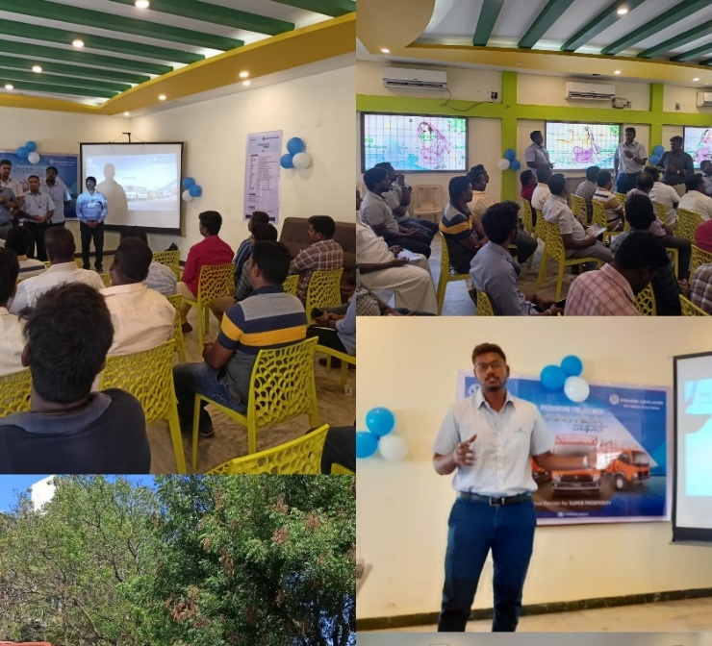
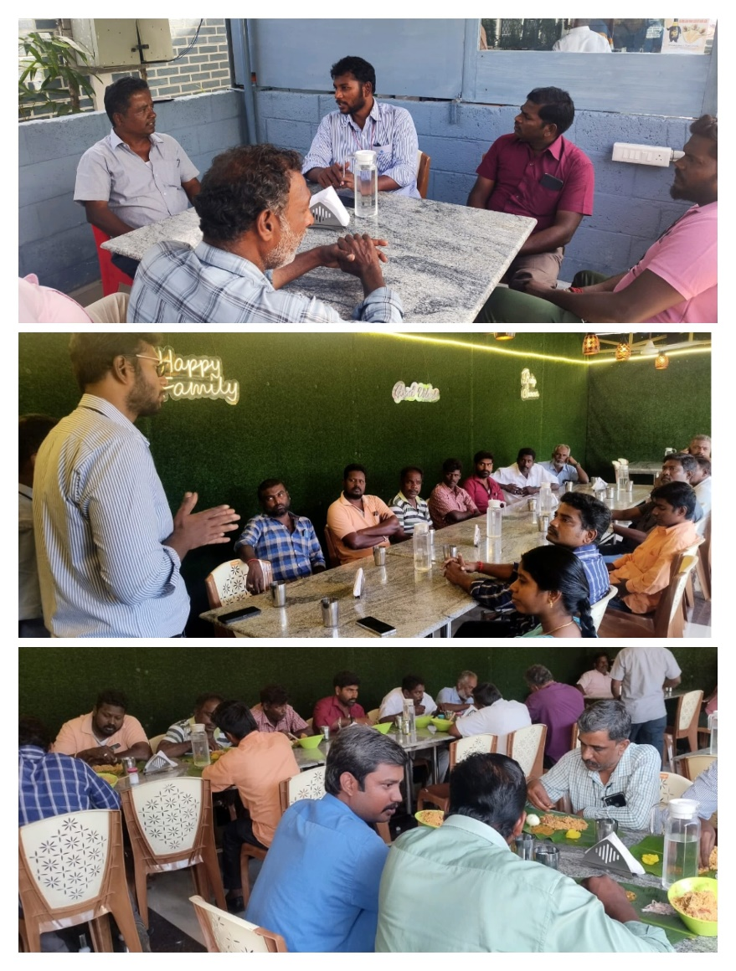
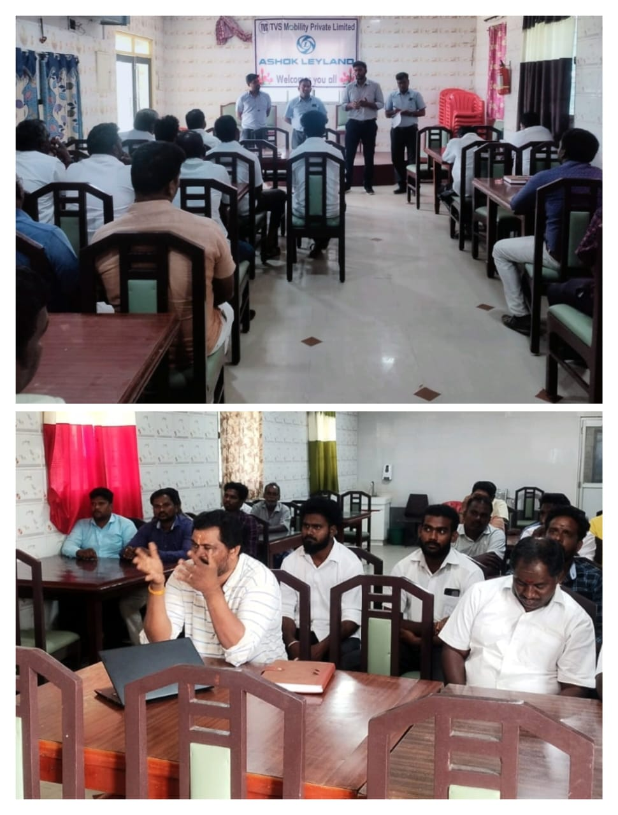
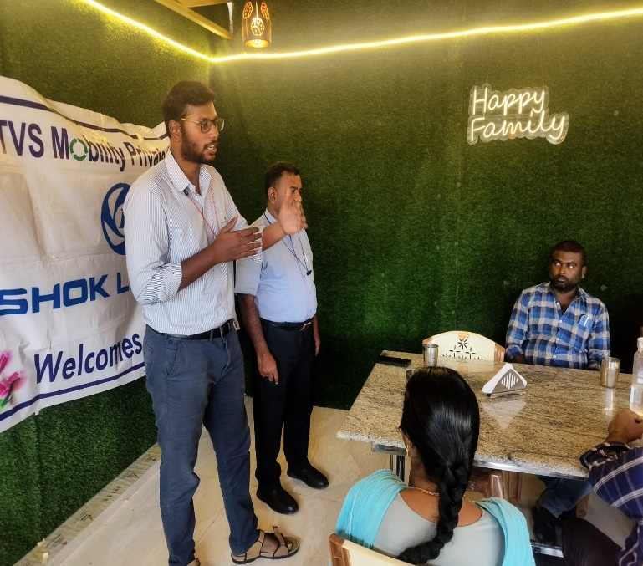
MAP : CUSTOMER MEET
PIC 1 : CHIDAMBARAM CUSTOMER MEET
PIC 2 : CUDDALORE CUSTOMER MEET
PIC 3 : TINDIVANAM CUSTOMER MEET
Notes:
Divider Slide

Slide 12
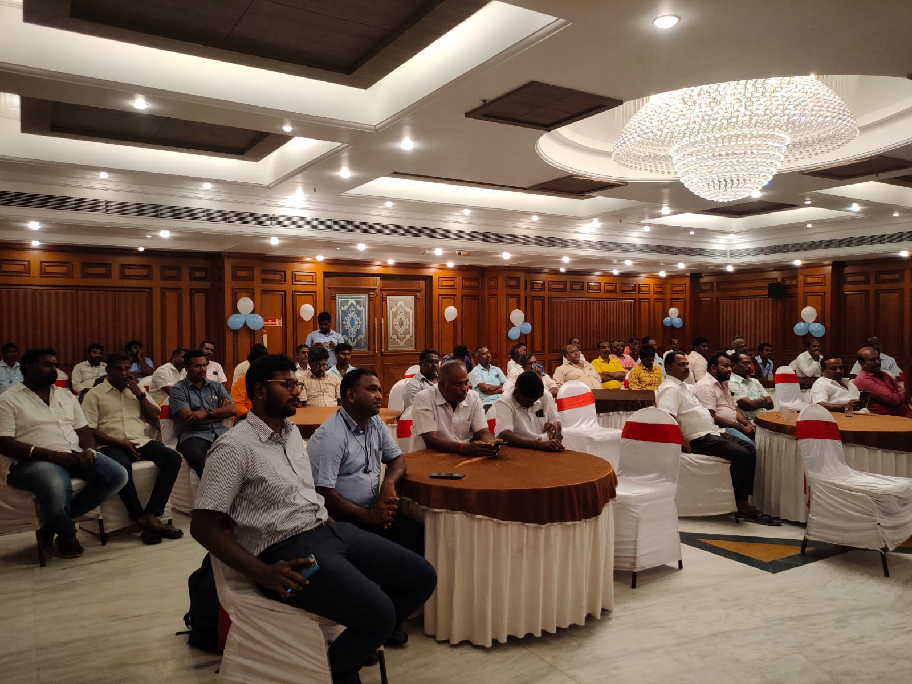
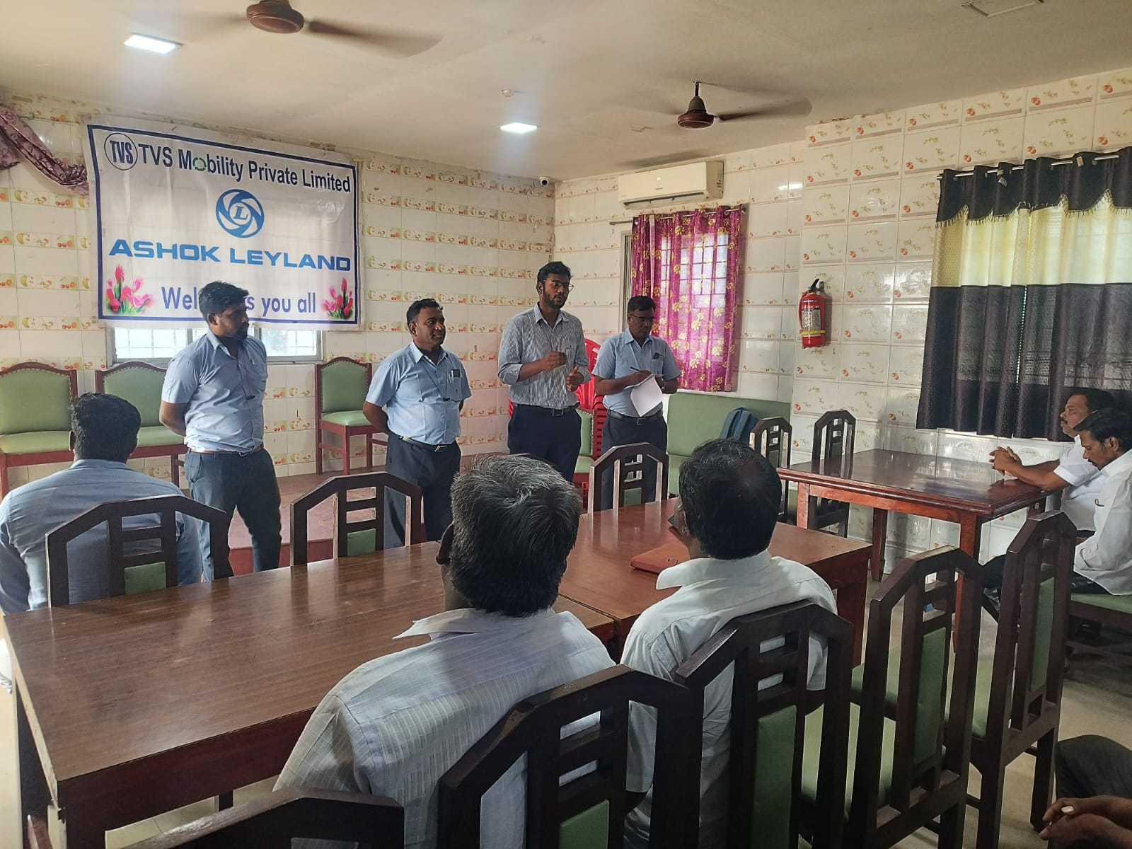
PONDY CUSTOMER MEET
TINDIVANAM CUSTOMER MEET

Slide 13
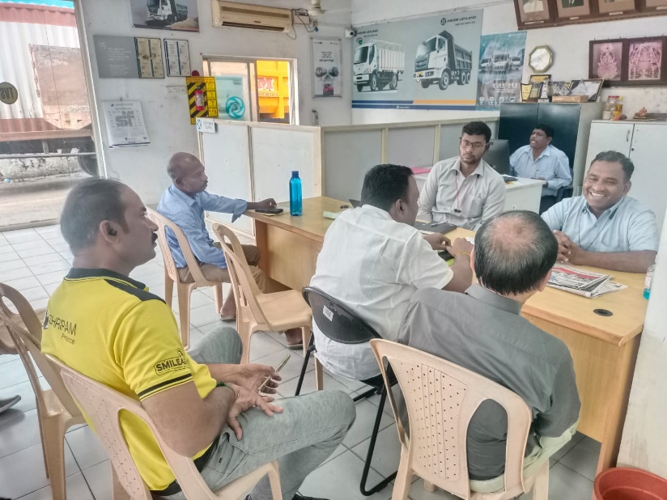
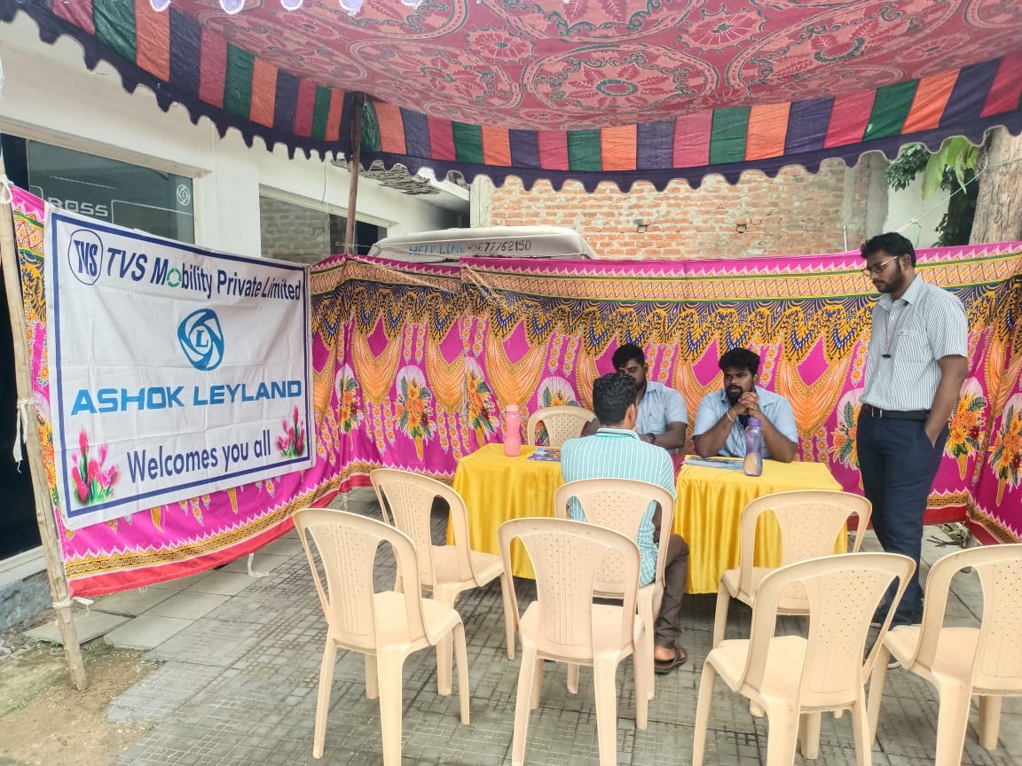
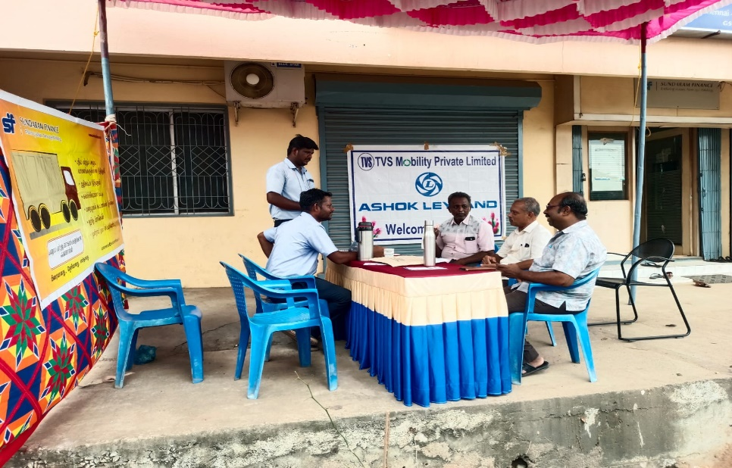
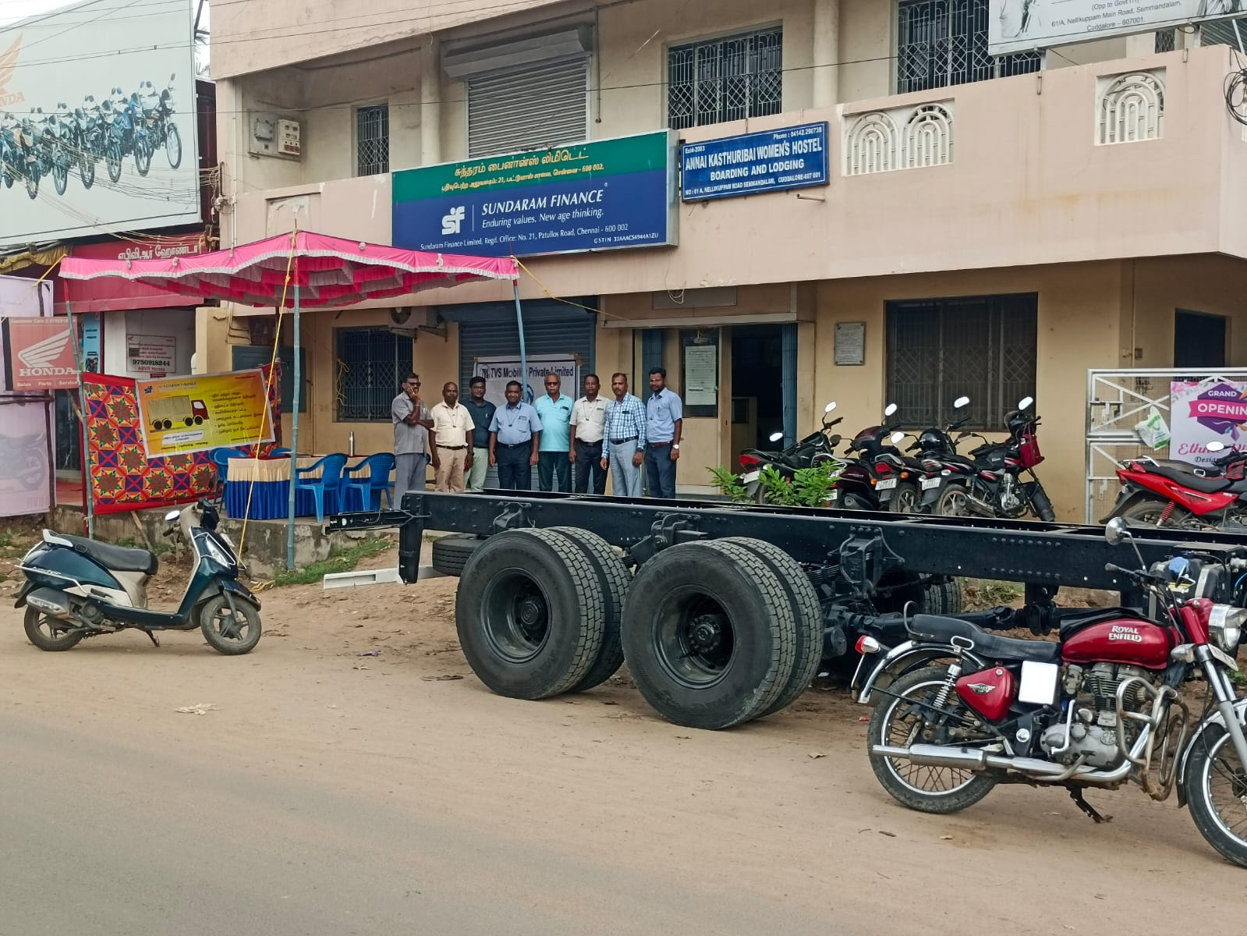
LOAN MELAS’S WITH FINANCIERS
PIC 1 : LOAN MELA WITH SRIRAM
PIC 2: LOAN MELA WITH YES BANK
PIC 3 & 4LOAN MELA WITH SFL
FINANCIERS
Notes:
Divider Slide

Slide 14
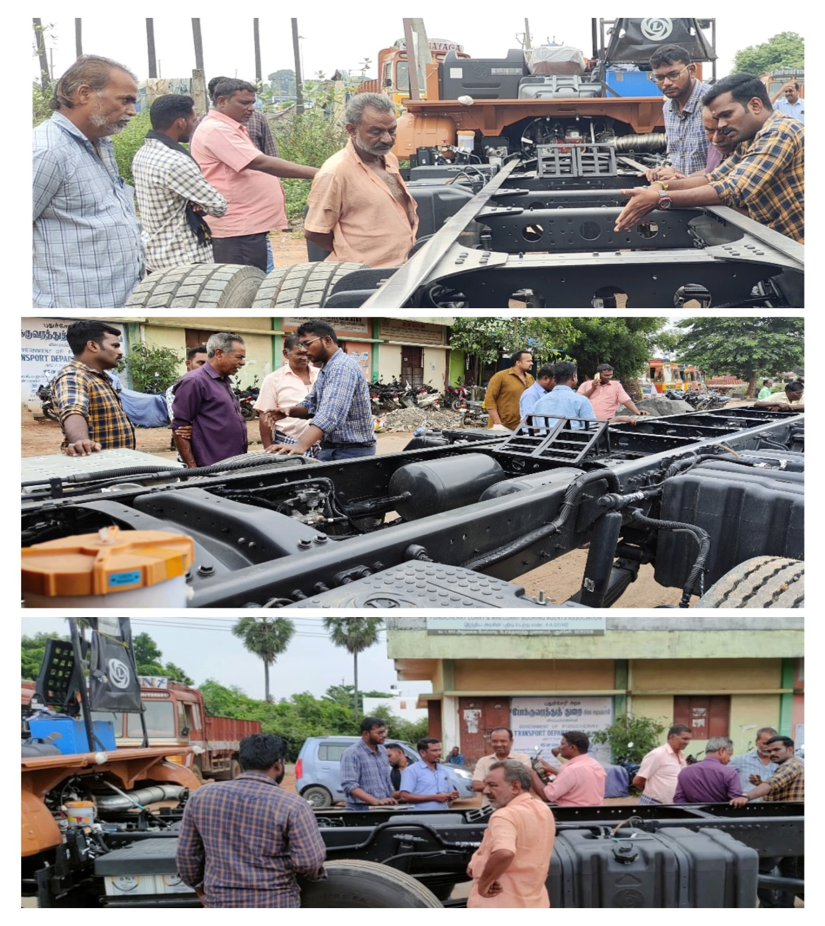
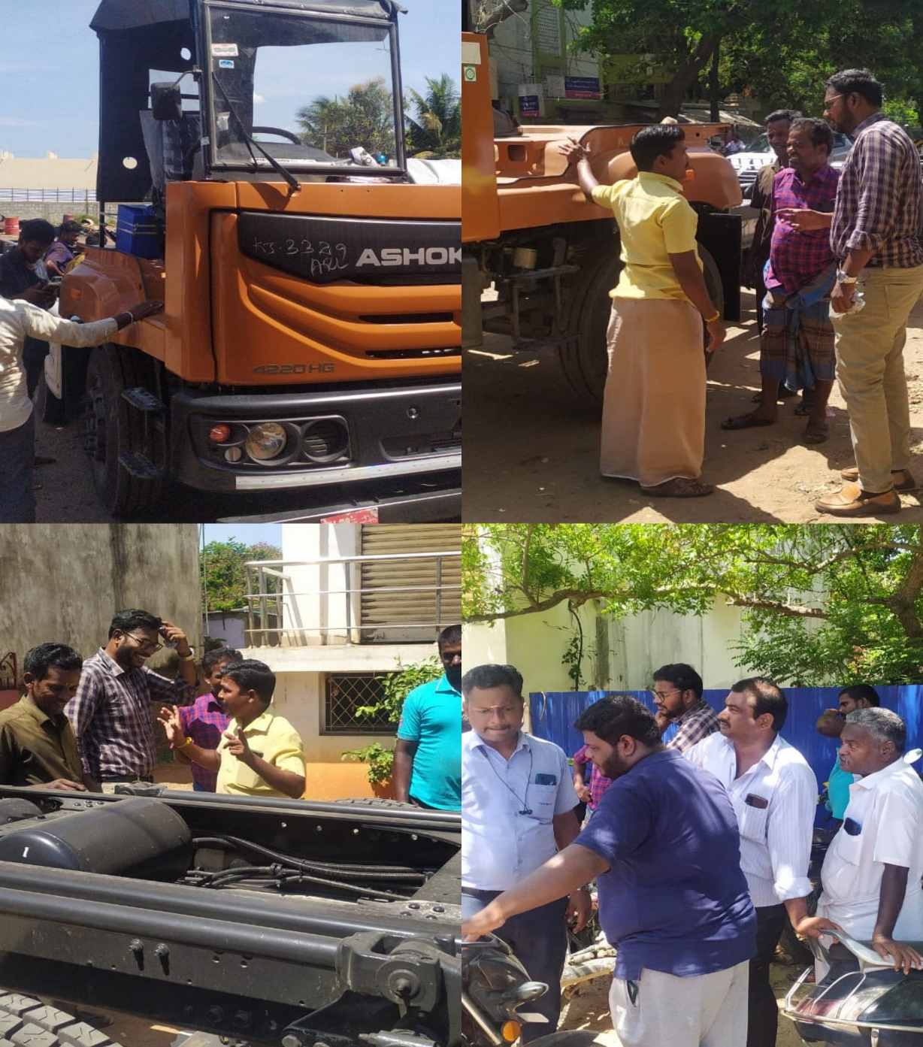
MAP : TOUCH & FEEL
Notes:
Divider Slide

Slide 15

Notes:
End slide

